Slide 1
Taking a Tour of Text Analytics
May 2017
Dr. Susan McKeever
CeADAR
Dublin Institute of Technology
School of Computing

Slide 2
Text analytics - we’ll cover :
A definition
Type of problems / applications
Difference from data analytics
Machine learning/ NLP
Some examples
Challenges

Slide 3
Text analytics is the process of deriving knowledge from text sources

Slide 4
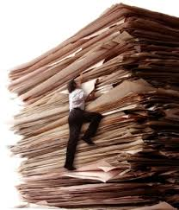
(Electronic) Text..
e.g.
Documents
Customer interactions
Reports
Articles
Emails
AND ….
80%?

Slide 5
(Electronic) Text..
External
A flood of social media text,
news,
user-generated content
Company
Emails
Documents
Customer interactions
Reports
Articles

Slide 6
Text Analytics technologies
Machine learning
Natural Language processing
Statistics
Information retrieval
We’re interested in the end destinations…

Slide 7
Many places to go..
Search and info retrieval
Fraud detection /claims investigation
Fraud detection /claims investigation
Medical pattern analysis
Fraud detection /claims investigation
Social Media
Analysis
Abusive content filtering
Customer
Care
Brand monitoring
Spam filtering
Cyber crime prevention
Knowledge
Manage’t
Risk Manage’t

Slide 8
Answering questions such as:
Are there any hidden trends in reasons given for insurance claims?
Are there any hidden common factors amongst patient histories with cancer?
What has opinion been on our new product range after a day? After 5 days?
Have there been any common CV characteristics amongst our best recruits over the last 10 years?

Slide 9
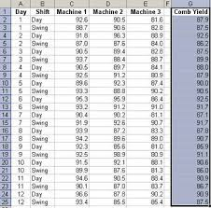
Digging in: Text versus Data
“Normal” Data is (relatively) easy to structure for analysis
Rows = data instances
Columns = features/attributes

Slide 10
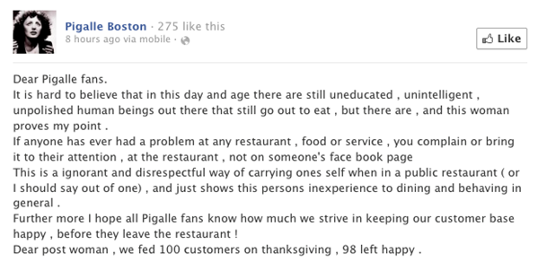
Digging in: Text versus Data
“Normal” Data is (relatively) easy to structure for analysis
Text is unstructured, with semantic complexity

Slide 11
Machine learning in text analytics
Set up/ training
Use

Slide 12
Machine learning in text analytics
Text sources
(=Documents)
e.g.
Emails, tweets
Set up/ training

Slide 13
Machine learning in text analytics
Features
Structured Data
Text sources
NAME
SALARY:LOAN
HOME
DEFAULT
Mike
0.25
N
yes
Bill
0.2
Y
no
Betty
0.33
Y
no
Bob
0.6
N
no
Dave
0.11
N
yes
Anne
0.33
N
yes
This text representation
as features is key
Set up/ training

Slide 14
Machine learning in text analytics
Features
Structured Dataset
Text sources
Predictive Analytics
NAME
SALARY:LOAN
HOME
DEFAULT
Mike
0.25
N
yes
Predictive Analytics
Bill
0.2
Y
no
Predictive Analytics
Betty
0.33
Y
no
Bob
0.6
N
no
Dave
0.11
N
yes
Anne
0.33
N
yes
Machine learning
Algorithm
“Learns” from the data set
Set up/ training

Slide 15
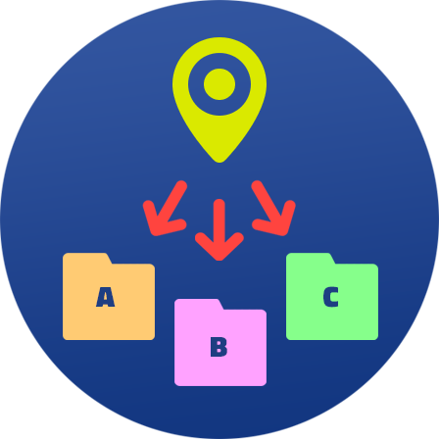
Supervised Machine learning in text analytics
Prediction
Labelled
Features
Structured Data
Text sources
Predictive Analytics
NAME
SALARY:LOAN
HOME
DEFAULT
Mike
0.25
N
yes
Predictive Analytics
Bill
0.2
Y
no
Predictive Analytics
Betty
0.33
Y
no
Use for:
Sentiment analysis
Document categorization
Filtering (e.g. spam)
Bob
0.6
N
no
Dave
0.11
N
yes
Anne
0.33
N
yes
Machine learning
Algorithm
Set up/ training

Slide 16
Unsupervised Machine learning in text analytics
Unlabeled
Features
Structured Data
Text sources
Predictive Analytics
NAME
SALARY:LOAN
HOME
DEFAULT
Mike
0.25
N
yes
Predictive Analytics
Bill
0.2
Y
no
Predictive Analytics
Betty
0.33
Y
no
Bob
0.6
N
no
Dave
0.11
N
yes
Anne
0.33
N
yes
Machine learning
Algorithm
Set up/ training

Slide 17
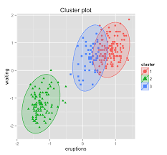
Unsupervised Machine learning in text analytics
Use for:
Automatic document grouping
Topic extraction
Unlabeled
Features
Structured Data
Text sources
Predictive Analytics
NAME
SALARY:LOAN
HOME
DEFAULT
Mike
0.25
N
yes
Predictive Analytics
Bill
0.2
Y
no
Predictive Analytics
Betty
0.33
Y
no
Bob
0.6
N
no
Dave
0.11
N
yes
Anne
0.33
N
yes
Machine learning
Algorithm
Cluster/grouping
Set up/ training

Slide 18
Machine learning: prediction/ clustering – Crosses most of these
Fraud detection /claims investigation
Sentiment analysis
Document categorization
Filtering e.g. spam .
Fraud detection /claims investigation
Medical pattern analysis
Fraud detection /claims investigation
Social Media
Analysis
Abusive content filtering
Customer
Care
Brand monitoring
Spam filtering
Cyber crime prevention
Knowledge
Manage’t
Risk Manage’t
Automatic document grouping
Topic extraction

Slide 19
Machine learning
Fraud detection /claims investigation
Fraud detection /claims investigation
Medical pattern analysis
Fraud detection /claims investigation
Social Media
Analysis
Abusive content filtering
Customer
Care
Brand monitoring4
Spam filtering
Cyber crime prevention
Knowledge
Manage’t
Risk Manage’t
But not enough…

Slide 20
This isn’t easy..
Features
Structured Data
Web
Public
Corpora
Corporate
Collections

Slide 21
Text representation :
How to “decode” this into a useful row of a dataset for training?

Slide 22
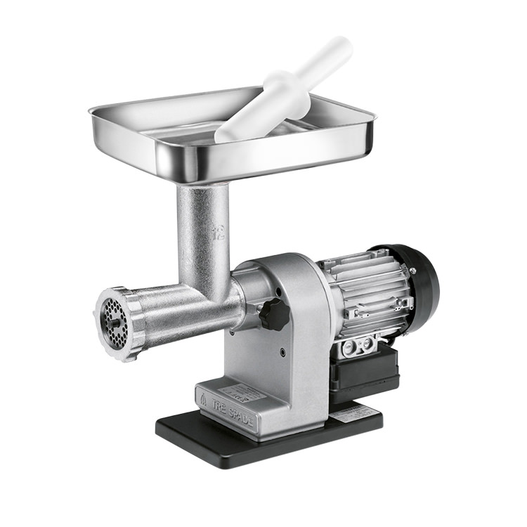
Text representation: Basic
Separate into words
(Or tokens/ n-grams)
“Documents”
 | the | patient | Is | a | male | with | history | of | diabetes | hypertension | and | CAD | presented | no | signs
PR1 | 1 | 1 | 1 | 2 | 1 | 1 | 1 | 1 | 1 | 1 | 1 | 1
PR2 | 1 | 1 |  |  |  | 1 |  | 1 |  |  |  | 1 | 1 | 1 | 1
1 document = 1 row (= 1 vector)
Feature reduction/redundancy
Structured data set for training
Which words occur, how often in each doc

Slide 23
Text representation: Basic
But semantics are often lost
“Man bites dog”
“Dog bites man”
Man | Bites | dog
1 | 1 | 1
1 | 1 | 1

Slide 24
Text representation: Basic
But semantics are often lost
“Man bites dog”
“Dog bites man”
Man | Bites | dog
1 | 1 | 1
1 | 1 | 1
Enter: Natural Language Processing

Slide 25
Natural Language processing
More powerful drilling into the actual meaning
“There were ten people living at 22 Station Road in Cork in 1914. Of these, three were minors. It is not thought that any of the residents were in danger when... “
e.g. Named Entity Recognition: Cork [place], 22 Station Road [address], 1914 [Time]
e.g. Parts of Speech tagging – Nouns: people, road, minors, residents Verbs: were, living… etc
And much more..

Slide 26
1 .Sentiment Analysis/ opinion mining
Measuring polarity of input text -
E.g. Is our new product popular?
What do our customers think of our service?
The “input text” is often from Social Media
? Your own systems?

Slide 27
1. Sentiment Analysis – ambiguity
“The hotel is in a great location with a fantastic view of the city “
“Fantastic location and a great view, yeah right”
Basic dictionary (lexicon) approach is not robust!

Slide 28
1. Sentiment Analysis – not easy
“The hotel is in a great location with a fantastic view of the city “
“Fantastic location and a great view, yeah right”

Slide 29
1. Sentiment Analysis: Machine learning
?
New Example
Labelled
Training examples
Text sources
Predictive Analytics
NAME
SALARY:LOAN
HOME
DEFAULT
Mike
0.25
N
yes
Predictive Analytics
Bill
0.2
Y
no
Predictive Analytics
Betty
0.33
Y
no
Bob
0.6
N
no
Dave
0.11
N
yes
Anne
0.33
N
yes
Machine learning
Algorithm
Sentiment
Boosted by NLP

Slide 30
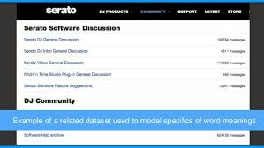
2. Topic modelling
Scenario: Too many (1000..0s+) “documents” to read, but we need to know what they’re about..
Patient history – common trends ?
Insurance claims – common unexpected factors?

Slide 31
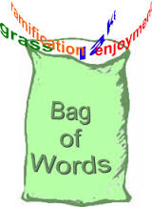
2. Topic modelling
“Documents” e.g. customer feedback emails
Topic 1: Cost, price, high, discount
Topic 2: Service, helpful, Saturday
....
Topic Modelling algorithm
e.g. LDA

Slide 32
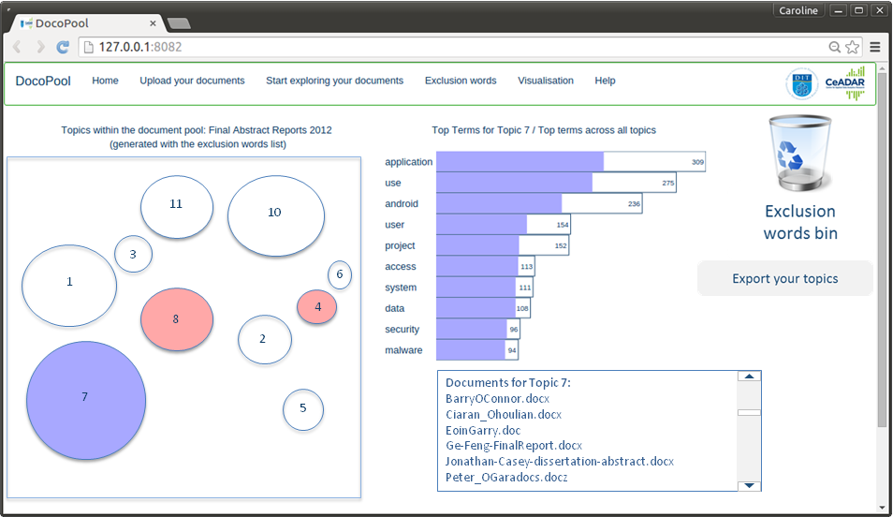
2. Topic modelling – CeADAR DocoPool
Explore topics, and documents

Slide 33
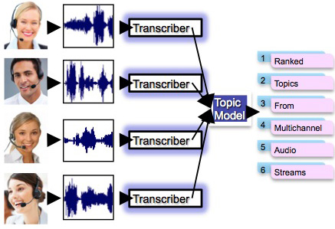
2. Topic modelling – CeADAR Topic Listener
Explore call centre and other audio driven sources: Discovers themes..

Slide 34
Deep learning for text analytics
Use of deep learning for encoding text into useful data
i.e. feature representation
E.g. Google’s Word2Vec model
Pre-trained vocabulary of billions of (unlabelled) word/ phrase examples available from Google
Active research area

Slide 35
Some challenges in text analytics
Text can be difficult to “get at” – legacy systems
Poor quality text (e.g. jargon, abbreviations)
Need for “local” labellers –
“Their coffee is wicked”
“Their coffee is wicked”
Multi lingual support
“Left of diagram”

Slide 36
Closing thoughts
Cart-before-horse: Can make sense to make an inventory of your text sources –internal and external - what knowledge might they hold?
Getting at the text can be hard
Text representation is key

Slide 37
Closing thoughts
Cart-before-horse: Can make sense to make an inventory of your text sources –internal and external - what knowledge might they hold?
Getting at the text can be hard
Text representation is key

